Slide 1

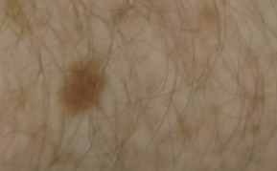
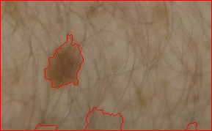
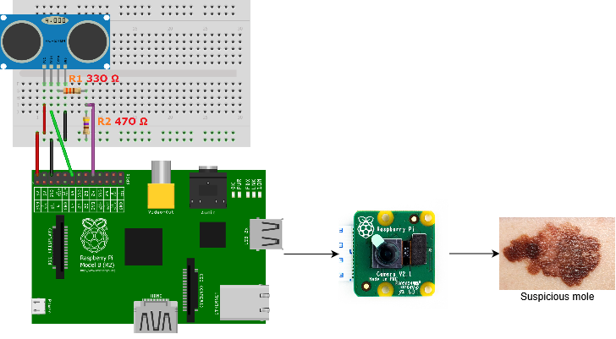
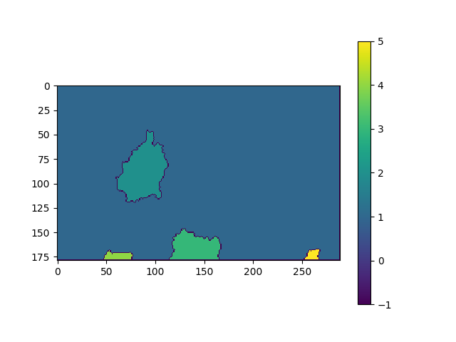
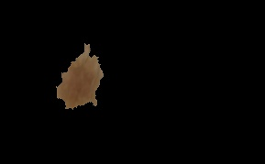

Melanoma (Skin Cancer) Long-Term Monitoring
Student name: Ciaran Carroll
ID Number: 13113259
Programme of study: Electronic & Computer Engineering (LM118)
Introduction
The specification of this project is to demonstrate the capabilities that Image processing techniques has in a medical context.
Specifically, we will be designing a system to facilitate the monitoring process of Melanoma or other types of skin cancer. The usefulness of such a product could have huge benefits & implications for the medical sector at large, particularly for patients in monitoring any changes in their malignant moles.
Due to the unpredictable nature of Melanoma, and the importance of monitoring its progress, the aiding of the monitoring process will lead to a reduction in the cost, skill level and knowledge required to monitor melanoma. As well as this, it would provide dramatic improvements in the treatment and outcome of diagnosed patients.
This is made possible as the malignant moles associated with the disease are visible on the skin.
A marker-based Image segmentation method was then used to partition the preprocessed image into meaningful labelled regions which was then used to separate the mole in the image from the skin and background. The Watershed algorithm proved useful for this application.
Various Image processing techniques were applied to the new image of the mole to extract information about its features.
A second image is taken of the mole in the same environment and processed with the same Image Processing steps.
The features of both images are compared forming the basis for the melanoma monitoring method. Any changes in the mole’s appearance will be measured.
Images above show stages of the image segmentation while using the watershed algorithm.
Segmenting the image will allow us to further analyse the mole using multiple Feature Extraction stages.
The Feature Extraction methods we will use in this project will be based on the ABCD method which is commonly used by GPs and Dermatologists to determine whether a mole is benign or malignant. The ABCD in this context stands for Asymmetry, Border irregularity, Diameter and Colour Variation.
Various Image Processing techniques will be required to prepare the image for feature extraction such as Shape descriptors, Otsu Thresholding and changing the colour space.
Description of feature extraction steps:
Counting the pixels in the region containing the moles allows us to calculate the moles pixel area.
Calculating a histogram of the region allows us to graphically see the number of pixels for each pixel value which shows the Colour Variation in the region.
Calculating the average distance the centre of the mole is to each of the edges allowed us to calculate the moles diameter.
Using the angle at which the centre point meets each of the edges allows us to determine whether the moles border was irregular in shape which would indicate that the mole is asymmetrical.
Comparing these features in images of a mole at various stages of the cancers development has proved to be a useful method for monitoring the progress of melanoma. The pixel areas, histograms, diameters and eccentricity of the moles will be used to determine if the mole has grown over time.
Aim
The overall aim of the system can be split into three separate sections:
Design a suitable environment for the monitoring system, powered by combining a camera module with a Raspberry Pi, to apply the Machine Vision.
Using the Raspberry Pi camera, take an image of the malignant mole. Furthermore, incorporate various Image processing techniques to separate the mole from its background to further extract information from the mole.
Create a method which monitors the progress of a malignant mole, by comparing and analysing images of the mole at various stages of its development.
Caption text to use Arial font, 20 point size, bold.
Results
Python script created on the Raspberry Pi will take an image of a mole with the camera module, undergo various Image Processing techniques on the image taken, and save the image at specific stages of the program on the system. The script is designed so that no overwriting occurs (new photo with a new name is created each time the script is executed).
Gaussian filter applied to the image, gives unsatisfactory results (hairs are still visible and defined in the image).
Specific type of Morphological operation called closing was applied instead of a filter, giving us our desired result (hairs are not defined in the image).
Marker-based Image segmentation using the Watershed Algorithm achieved our goal of partitioning and labelling the image into meaningful regions. One of these regions contained the mole that will be analysed.
A new image will be created with all the other labelled regions modified to appear black creating the segmented image containing only the mole.
Method
A Raspberry Pi and camera module was acquired, which will allow the system to take an image of a suspicious mole, process it and save it on the Raspberry Pi.
The combination of the camera module connected to a Raspberry Pi, condescend light sources and white backdrop create a suitable environment for the monitoring system.
An ultrasonic sensor was integrated with the system to measure the distance of the mole from the camera.
Voltage was applied to the ultrasonic sensor using the built-in Raspberry Pi GPIO (3.3V for Vin).
The Machine Vision aspect of the project required combining various steps for Image Processing such as Preprocessing, Segmentation and Feature Extraction.
Preprocessing the image of the mole involved using Morphological operations to remove the effect of hairs and noise from the image.
Conclusion and personal reflection
I believe the design & implementation of this above system have been achieved effectively. While there is further room for improvement required for making this a complete product, the overall functionality provides a solid foundation from which to refine and perfect.
Certain aspects of the project, such as the way the product interacts with its users and the portability of the entire system could have been improved. This could have been achieved by integrating a LED circuit to provide the light source and developing an Android application to allow users to easily interact with the product.
Overall, I think this project as a whole was perfect for giving me a platform to go on to learn many skills (such as Python programming and Machine Vision). At the same time, it allowed me to apply these skills to a real-world application whose impact could potentially improve the treatment and outcome of patients diagnosed with melanoma.
Original image
Image w/ labelling applied
Acknowledgements
I would like to thank both of my supervisors, Dr Sean McGrath & Dr Colin Flanagan. Their help & assistance proved vital within both the design & implementation process of the project.
Basic Diagram showing how the hardware and sensor of the system interact with one another
Watershed marker labelling
Segmented image

